Slide 1
Go language
Anand Hariharan
Practice Head, Google

Slide 2
Module 11 & 12
concurrency and parallelism
concurrency with goroutines
async and wait
channels
coordinating channels
channel timeout
hands on exercises

Slide 3
Concurrency & parallelism
Concurrency is a Model for Software Construction (Rob Pike)
Concurrency is NOT parallelism
Concurrency can exist even when there is a single CPU but it will not be parallel
It enables parallelism. A concurrent program enhances the impact of parallelism
Notes:
https://www.youtube.com/watch?v=f6kdp27TYZs
http://stackoverflow.com/documentation/go/376/concurrency#t=201611131602520725089
http://guzalexander.com/2013/12/06/golang-channels-tutorial.html
Measuring execution time in Go - https://coderwall.com/p/cp5fya/measuring-execution-time-in-go
func main() {
// Data is irrelevant
done := make(chan struct{})
go func() {
println("goroutine message")
// Just send a signal "I'm done"
close(done)
}()
println("main function message")
<-done
}

Slide 4
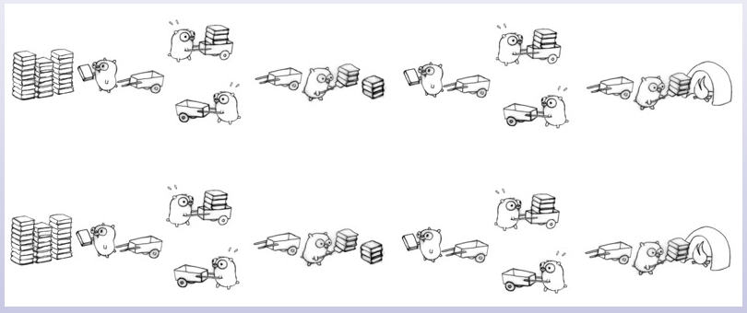
Visualizing concurrency

Slide 5
Goroutine
A goroutine is an independently executing function launched by a “go” statement
E.g. go <function_name> //Launches a Go routine
It has its own call stack which can grow and shrink as required
It is NOT a thread. A thread can have hundreds or thousands of goroutines.
Communication between goroutines is critical to making concurrency work

Slide 6
Concurrency
Implemented using
goroutines
channels
select
goroutine is an independently executing function executed by the “go” statement
Goroutines are multiplexed into a small number of OS threads
They don’t map 1:1 with OS threads
Growable, segmented stacks which startup faster than threads
Go routines communicate via channels
Channel provides a connection between two goroutines allowing them to communicate
Notes:
See http://tleyden.github.io/blog/2014/10/30/goroutines-vs-threads/ for more info

Slide 7
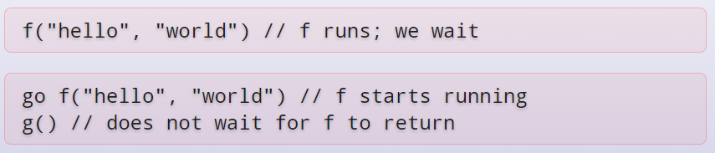
Example
Program execution begins by initializing the main package and then invoking the function main. When that function invocation returns, the program exits. It does not wait for other (non-main) goroutines to complete.

Slide 8
Channels
Channels are the pipes that connect concurrent goroutines.
You can send values into channels from one goroutine and receive those values into another goroutine.
Use make(chan val-type) to create a new channel
Channels are typed by the values they convey
The arrow points the direction in which the channel is sending data
To send on a channel, use chan <-
To receive from a channel, use <-chan

Slide 9
Channel buffering
By default channels are unbuffered, meaning that they will only accept sends (chan <-) if there is a corresponding receive (<- chan) ready to receive the sent value.
Buffered channels accept a limited number of values without a corresponding receiver for those values.

Slide 10
Channel Synchronization
Channels do two key functions:
They communicate
They synchronize
A sender and receiver must both be ready to play their part in the communication. Otherwise we wait until they are.
<- chan thus acts as a blocking function

Slide 11
Channel direction
When using channels as function parameters, you can specify if a channel is meant to only send or receive values.
This specificity increases the type-safety of the program.
chan<- : Declaration for a send-only channel
<-chan : Declaration for a receive-only channel

Slide 12
Select case & Non-blocking goroutine

Slide 13
Closing a channel and range over channel
A sender can close a channel to indicate that no more values will be sent.
Receivers can test whether a channel has been closed by assigning a second parameter to the receive expression
v, ok := <-ch
ok will be false if there are no more values and the channel is closed
Sending on a closed channel will cause a panic.
Channels aren't like files; you don't usually need to close them.
Closing is only necessary when the receiver must be told there are no more values coming, such as to terminate a range loop.
Notes:
Only the sender should close a channel, never the receiver.

Slide 14
Anand Hariharan
Practice Head
anand.hariharan@wipro.com

